Slide 1
1-Data Academy Fundamental PostGIS
Randy Galawana
Data Engineer

Slide 2
1-Data Academy Fundamental PostGIS
01
Introduction
02
Hands On
03
Quiz
GIS in PostgreSQL
Spatial Data Type
Spatial Index
Spatial Function
Loading Spatial Data
Geometry
Clustering
Spatial Join

Slide 3
PostGIS?
PostGIS is a spatial database extender for PostgreSQL object-relational database. It adds support for geographic objects allowing location queries to be run in SQL.
https://postgis.net/
What is a spatial database?
System for storage and random access of relationally (tables of rows and columns) structured data, providing the following capabilities for that data.
Data Types including Spatial Types
number, date, string, geometry, geography and raster
Indexes including Spatial Indexes
b-tree, hash, rtree, quadtree
Functions including Spatial Functions
strlen(string), pow(float, float), now(), ST_Area(), ST_Distance()
Spatial databases store and manipulate spatial objects like any other object in the database.

Slide 4
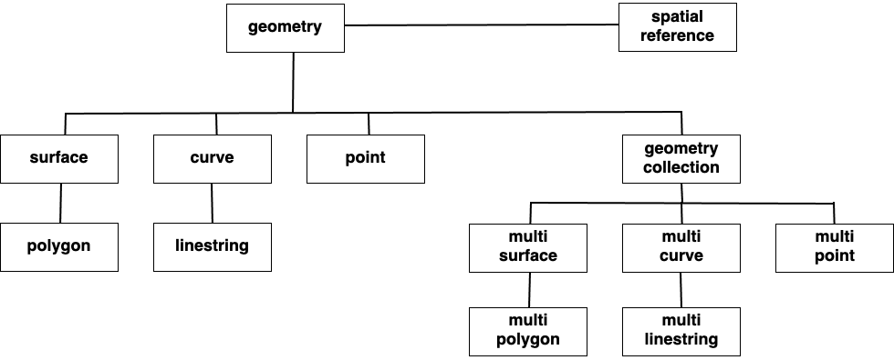
Spatial Data Types

Slide 5
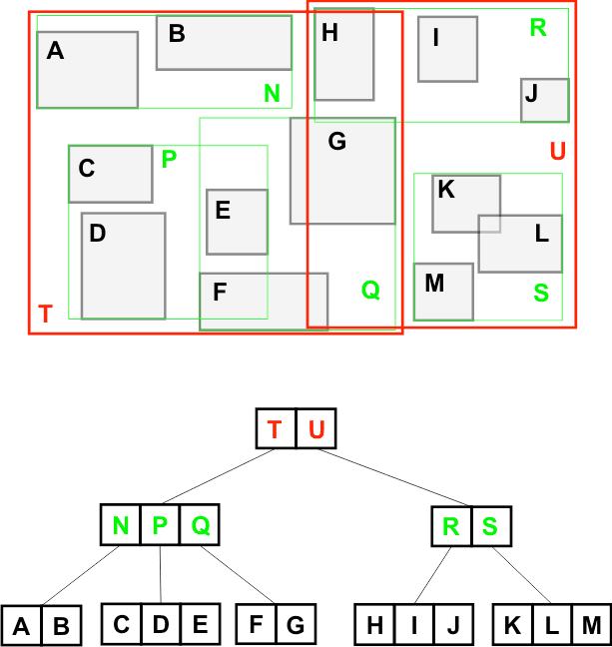

Spatial Index
This R-Tree organizes the spatial objects so that a spatial search is a quick walk through the tree.
To find what object contains ?
The system first checks if it is in T or U (T)
Then it checks if it is in N, P or Q (P)
Then it checks if it is in C, D or E (D)
Only 8 boxes have to be tested. A full table scan would require all 13 boxes to be tested. The larger the table, the more powerful the index is.

Slide 6
Spatial Functions
Spatial functions allow you to perform advanced spatial analysis and combine spatial data types with other spatial data types or data in other formats like float,
For example:
ST_GeometryType(geometry) → text
ST_Area(geometry) → float
ST_Distance(geometry, geometry) → float
ST_Buffer(geometry, radius) → geometry
ST_Intersection(geometry, geometry) → geometry
ST_Union([geometry]) → geometry

Slide 7
Hands On
Download sample data and workshop transcript from
https://github.com/galawana/1datapostgis

Slide 8
Loading Spatial Data
We need postgis tools to load Spatial Data for PostgreSQL we can use shp2pgsql (included in PostGIS installation)
Shp2pgsql -D -I -s <SRID Code>\
<location_file_shp> <table_name> \
| psql --dbname=<dbname> \
--username=<username> \
--host=<server_ip> \
--password
shp2pgsql
supports only shape file
supports only pgsql
minimal processing options
comes with postgis
simpler command line
generates SQL file to pass into the database
Optional Attribute
-s : <SRID Code> Can be find from query
SELECT srid, srtext, proj4text FROM spatial_ref_sys WHERE srtext ILIKE ‘%<SRTEX>%’
Value of SRTEX cant be taken on .prj File
-D : Dump format
-I : build Spatial Index

Slide 9
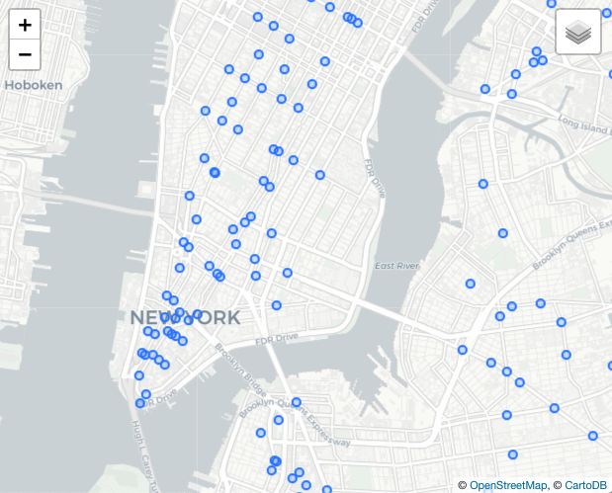
Geometries - Points
“Point” or “MultiPoint”, representing one or more 0-dimensional locations.
BTS (Tower), Lacci, Places, might all use a “Point” geometry type.
Hands On
Create POINT from table site with longitude and latitude columns
Show Text format of Points types from given table
Extract Point data type to get longitude and latitude

Slide 10
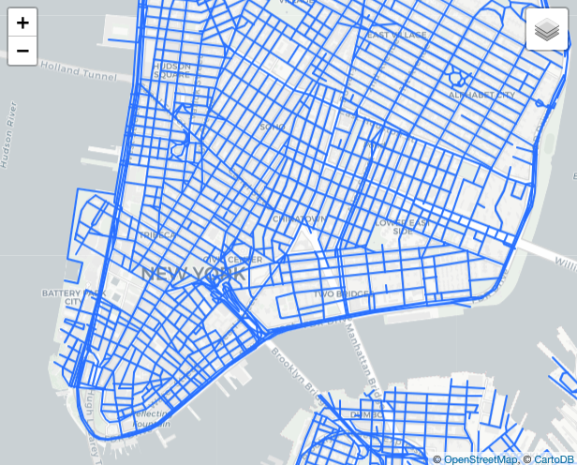
Geometries - LineStrings
“LineString” or “MultiLineString”, representing one or more 1-dimensional objects.
Streets, streams, bus routes, power lines, driven routes, highways, might all use a “LineString” geometry type.
Hands On
Select LineString from table `jalan_raya` with geom columns
Show Text format of LineStrings types from table `jalan_raya`
Calculate Length of LineStrings from table `jalan_raya`
Get Start and Endpoint of LineStrings
Get number of point from LineStrings

Slide 11
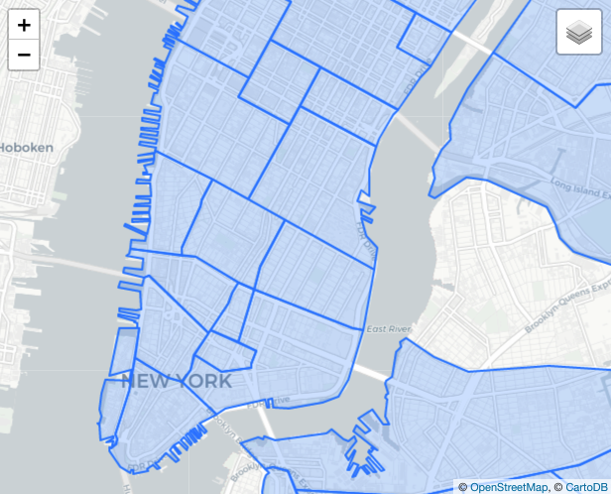
Geometries - Polygons
“Polygon” or “MultiPolygon”, representing one or more 2-dimensional objects.
Census areas, parcels, boundaries, countries, neighborhoods, zoning areas, watersheds, and more.
Hands On
Select Polygon from table `batas_kecamatan` with geom columns
Show Text format of Polygons types from table `batas_kecamatan`
Calculate Area of polygons from table `batas_kecamatan`
Calculate Perimeter length of polygons from table `batas_kecamatan`

Slide 12
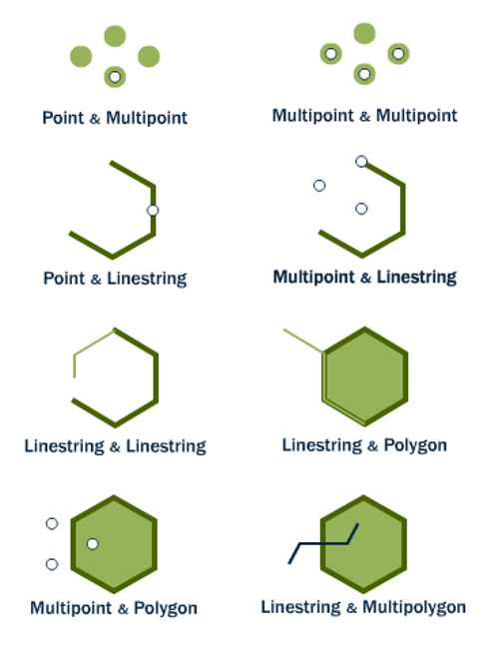
Spatial Joins
ST_Intersects(A, B) ST_Disjoint(A, B)
Intersects and disjoint are opposites. Any kind of interactions between two shapes is an intersection, and implies the pair are not disjoint, and vice versa.
A intersects B ⇒ A not disjoint B
A disjoint B ⇒ A not intersects B
Hands On
Check Which Site Intersect with kecamatan Sukaraja in Eastern Jabotabek Region
Count how many main Roads crossing Region SUMBAGUT
Check which site id JKTXXX which not in region Central Jabotabek

Slide 13
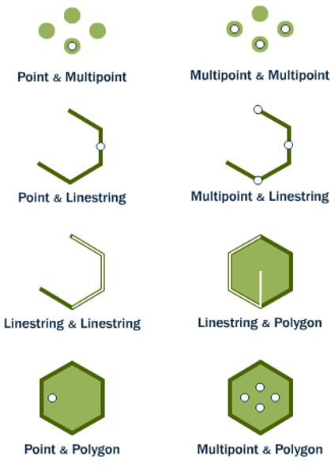
Spatial Joins
ST_Within(A, B) ST_Contains(B, A)
ST_DWithin(A, B, distance_degree)
Within and contains are about objects being fully inside. One important caveat, for both functions an object on the boundary is not considered within. So a point on the outer ring of a polygon is not within the polygon.
ST_Within(A, B) == ST_Contains(B, A)
Dwithin is object within distance of boundary object
Hands On
Check Which `site` contains in kecamatan ‘Tangerang’ in table `batas_kecamatan`

Slide 14
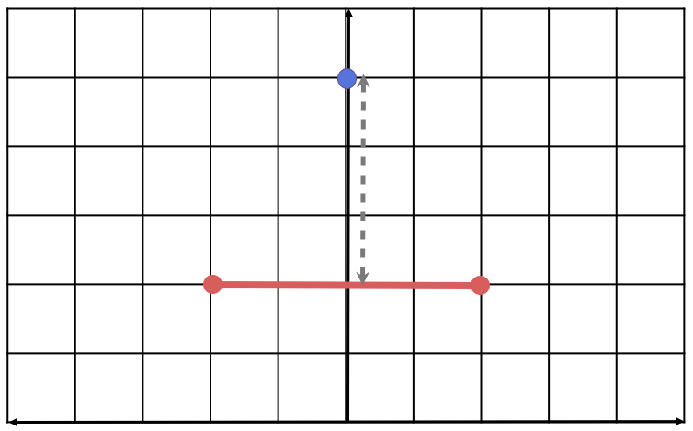
Spatial Joins
ST_Distance(A, B)
Returns the shortest distance between the two geometries, in this case the distance from the point to the line mid-point.
Hands On
Calculate Distance between each site prefix BDG
Calculate Distance between site BDG and Primary Road

Slide 15
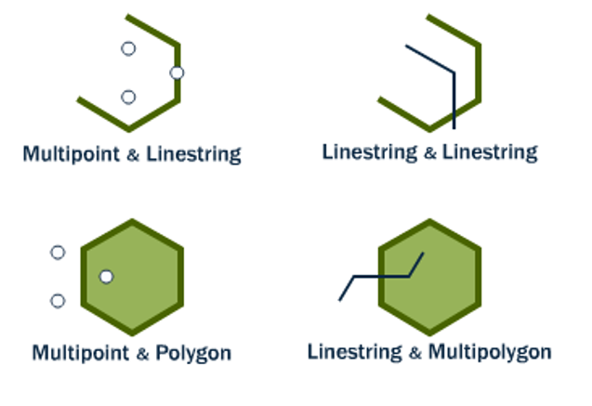
Spatial Joins
ST_Crosses(A, B)
Mostly used to test linestrings, which can be said to cross when their interiors have interactions.
When linestrings cross polygon boundaries, the crosses condition is also true.
Hands On
Check Which `jalan_raya` crosses with other `jalan_raya` Primary Routes

Slide 16
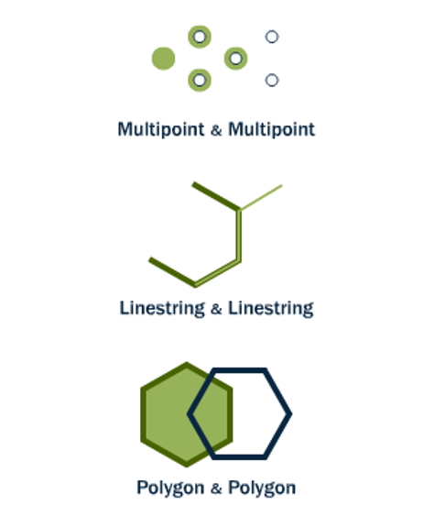
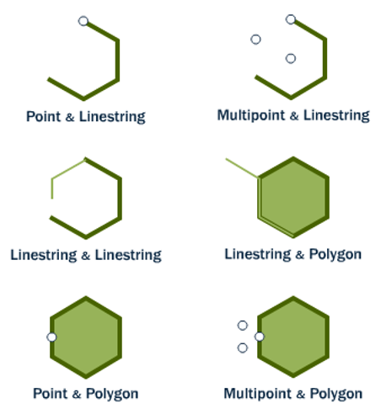
Spatial Joins
ST_Overlaps(A, B)
Shapes overlap when their interiors interact with each other and also with the exterior of the shape.
So objects that are contained or within do not overlap, overlaps is what normal people might call “partial overlap”.
ST_Touches(A, B)
Shapes touch when their boundaries interact but their interiors do not. End points for lines, exterior rings for polygons. Usually used for testing that polygons have ring-touching only.

Slide 17
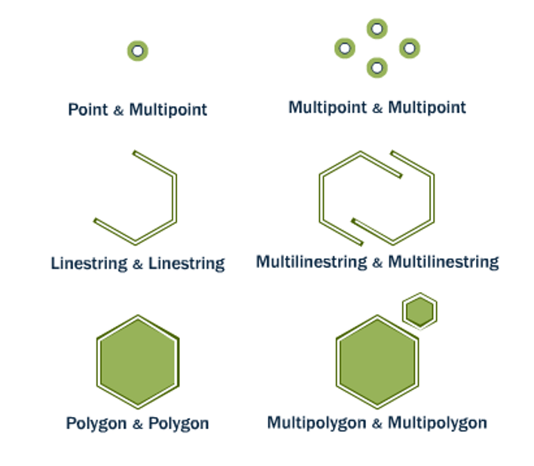
Spatial Joins
ST_Equals(A, B) ST_OrderingEquals(A, B)
Equals tests that A and B cover the same space, regardless of representation differences (extra vertices, order of vertices). OrderingEquals insists on structural identity.

Slide 18
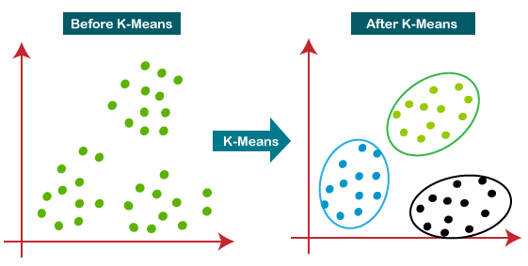
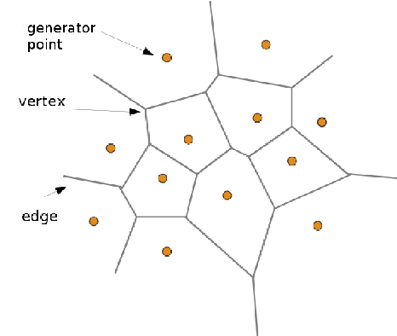
Clustering
ST_ClusterKMeans(A, cluster_num)
K-means clustering is an algorithm that divides a set of points into a specified number of clusters based on the mean distance of points from the centroid (mean) of each cluster.
The ST_ClusterKMeans function in PostGIS takes a single parameter: the number of clusters to create
ST_VoronoiDiagram(A)
A Voronoi diagram is a partitioning of a plane into regions based on distance to a set of points. Each region represents the area of the plane that is closest to a particular point.

Slide 19
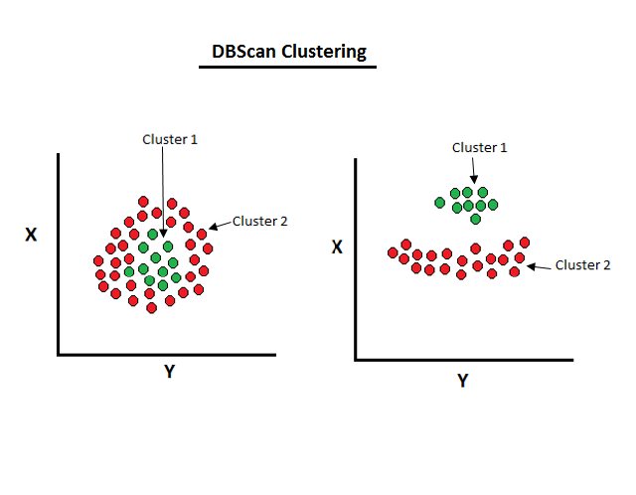
Clustering
ST_ClusterDBSCAN(A, eps, min_points)
DBSCAN (Density-Based Spatial Clustering of Applications with Noise) is an algorithm that clusters points based on density. Points in a high-density region are considered to be part of the same cluster, while points in a low-density region are considered to be noise (i.e., not part of any cluster).
The ST_ClusterDBSCAN function in PostGIS takes two parameters: eps and minpoints. eps is the maximum distance that points in a cluster can be from each other, and minpoints is the minimum number of points required to form a cluster.
Hands On
Clustering Site based on DBSCAN
Clustering Site based on Voronoi Diagram
Clustering Site based on KMeans

Slide 20
Thank You
© Telkomsel 2022

